Slide 1
Gaussian Elimination
By
Dr. Md. Rajibul Islam
CSE, UAP

Slide 2
Naïve Gaussian Elimination
A method to solve simultaneous linear equations of the form [A][X]=[C]
Coefficient matrix
Right-hand side vector
Solution vector/ unknown vector
Two steps
1. Forward Elimination
2. Back Substitution

Slide 3

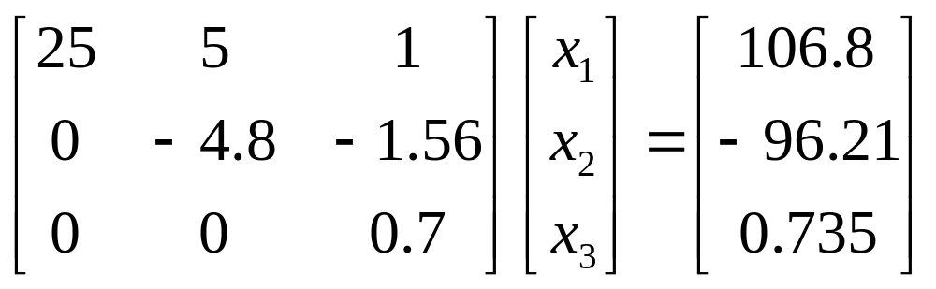
Forward Elimination
The goal of forward elimination is to transform the coefficient matrix into an upper triangular matrix

Slide 4
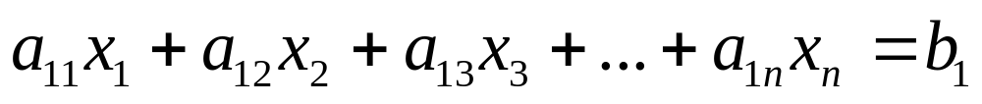

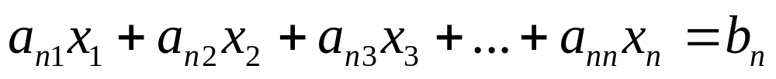
Forward Elimination
A set of n equations and n unknowns
. .
. .
. .
(n-1) steps of forward elimination

Slide 5

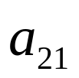
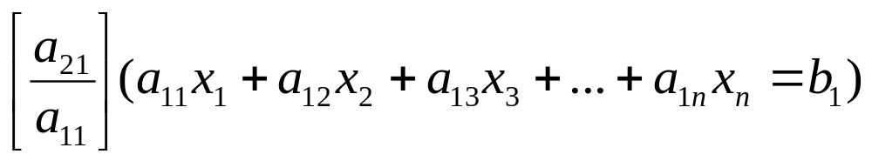
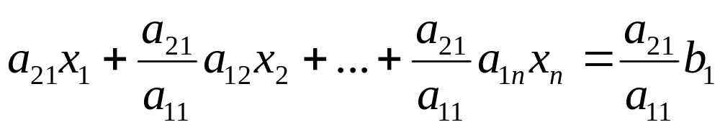
Forward Elimination
Step 1
For Equation 2, divide Equation 1 by and multiply by .

Slide 6
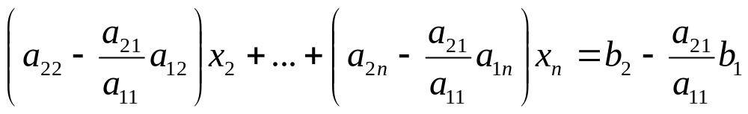
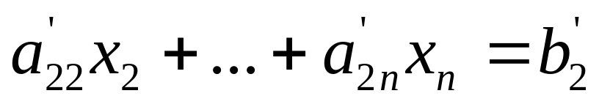
Forward Elimination
Subtract the result from Equation 2.
−
_________________________________________________
or

Slide 7
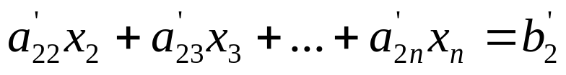
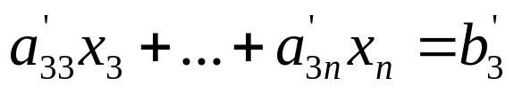
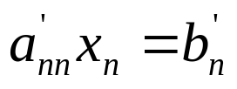
Forward Elimination
Repeat this procedure for the remaining equations to reduce the set of equations as
. . .
. . .
. . .
End of Step 1

Slide 8
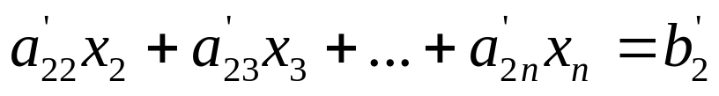
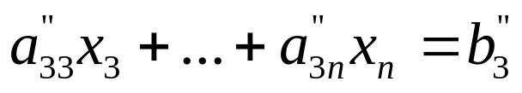
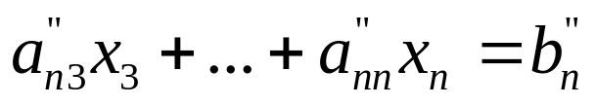
Forward Elimination
Step 2
Repeat the same procedure for the 3rd term of Equation 3.
. .
. .
. .
End of Step 2

Slide 9
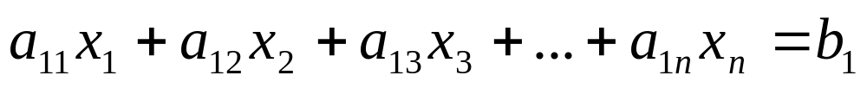

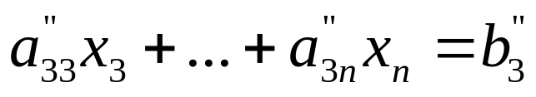
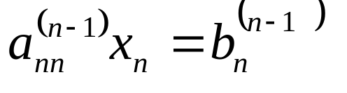
Forward Elimination
At the end of (n-1) Forward Elimination steps, the system of equations will look like
. .
. .
. .
End of Step (n-1)

Slide 10
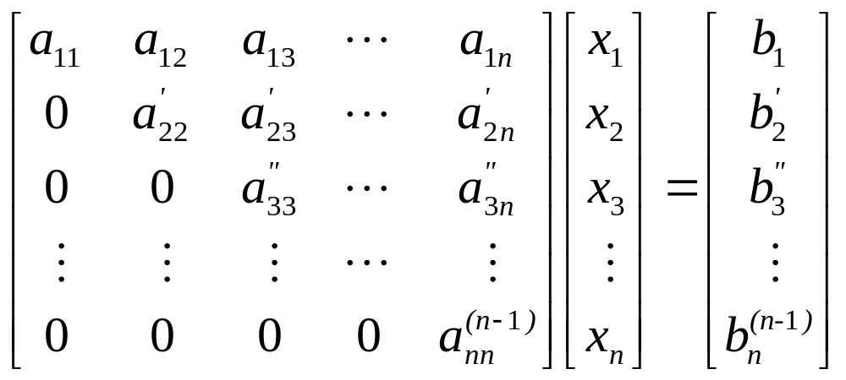
Matrix Form at End of Forward Elimination

Slide 11
Back Substitution
Solve each equation starting from the last equation
Example of a system of 3 equations

Slide 12
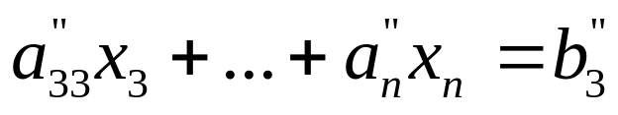
Back Substitution Starting Eqns
. .
. .
. .

Slide 13
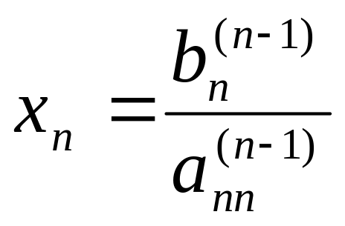
Back Substitution
Start with the last equation because it has only one unknown

Slide 14

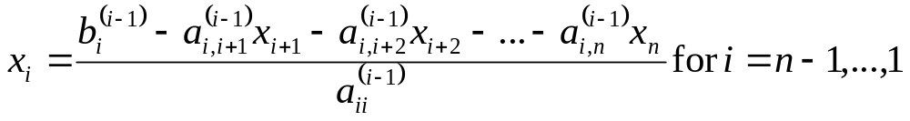
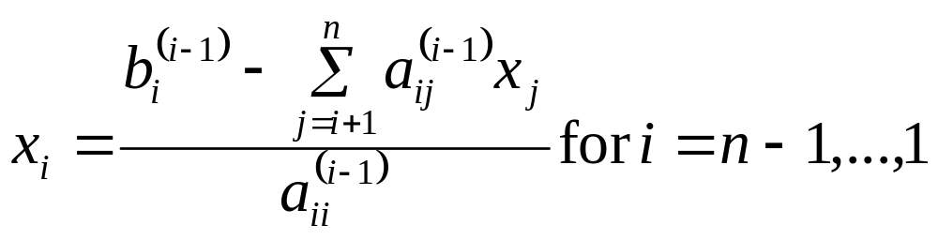
Back Substitution
corresponding values of x which will be involved in the negative elements
divided by the diagonal element corresponding to that unknown

Slide 15
THE END

Slide 16
Naïve Gauss Elimination
Example

Slide 17

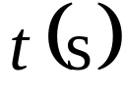
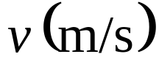
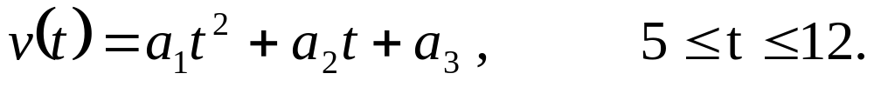
Example 1
The upward velocity of a rocket is given at three different times
Table 1 Velocity vs. time data.
Time, | Velocity,
5 | 106.8
8 | 177.2
12 | 279.2
The velocity data is approximated by a polynomial as:
Find the velocity at t=6 seconds .

Slide 18
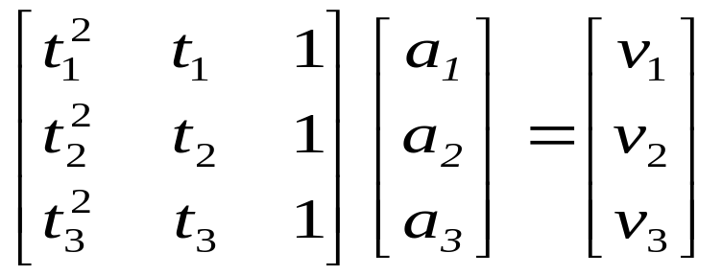

Example 1 Cont.
Assume
Results in a matrix template of the form:
Using data from Table 1, the matrix becomes:

Slide 19
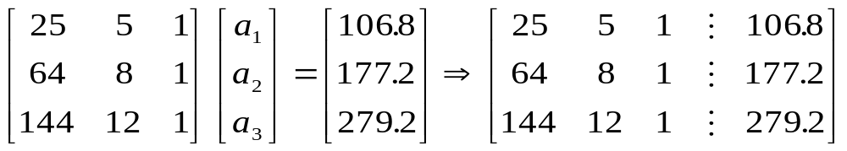
Example 1 Cont.
Forward Elimination
Back Substitution

Slide 20
Forward Elimination

Slide 21
Number of Steps of Forward Elimination
Number of steps of forward elimination is
(n−1)=(3−1)=2

Slide 22
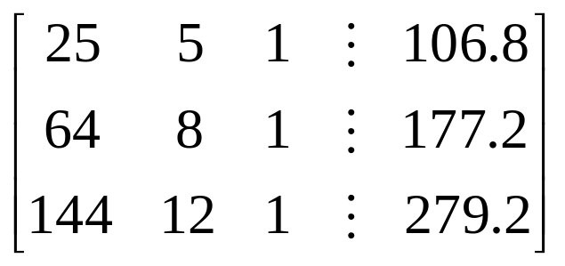
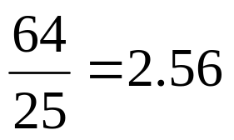
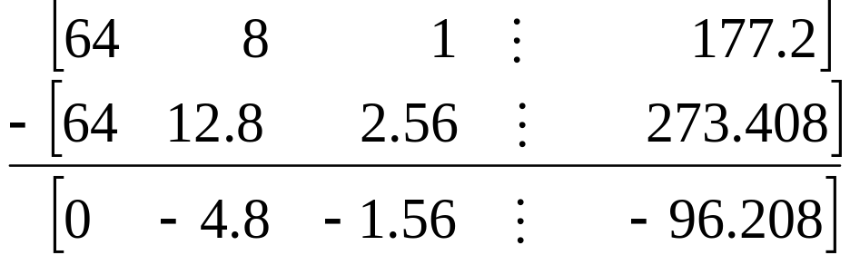
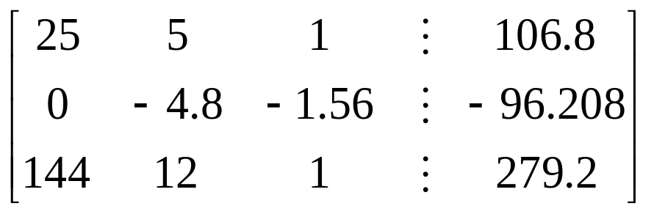
Forward Elimination: Step 1
Divide Equation 1 by 25 and
multiply it by 64, .
.
Subtract the result from Equation 2
Substitute new equation for Equation 2

Slide 23

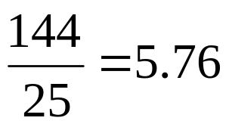
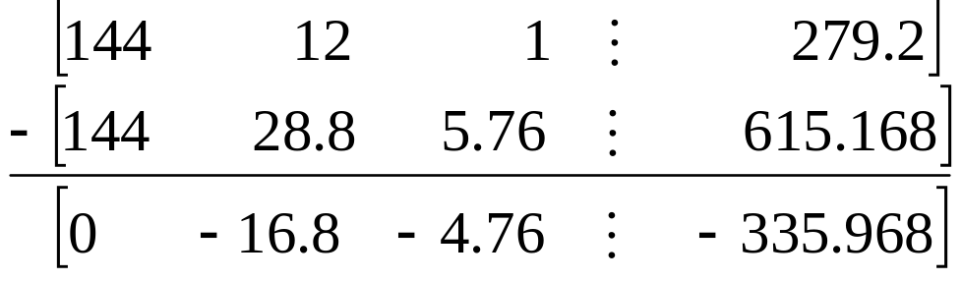
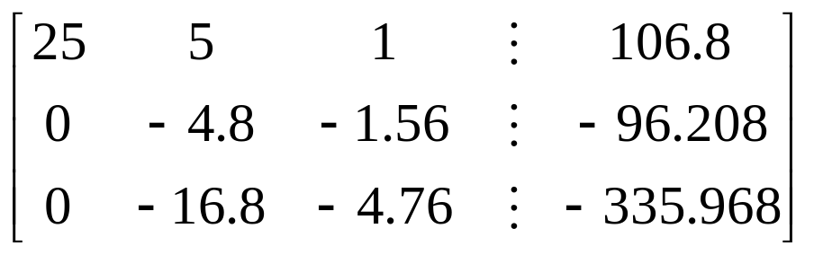
Forward Elimination: Step 1 (cont.)
Divide Equation 1 by 25 and
multiply it by 144, .
.
Subtract the result from Equation 3
Substitute new equation for Equation 3

Slide 24

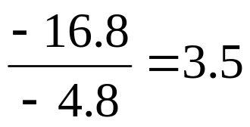
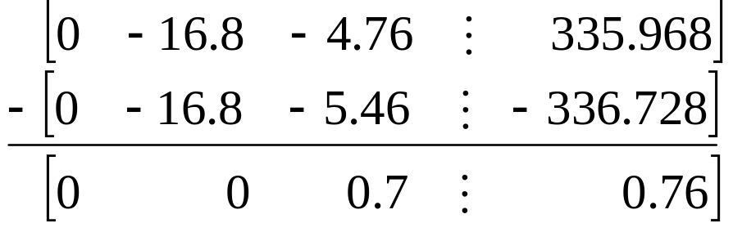
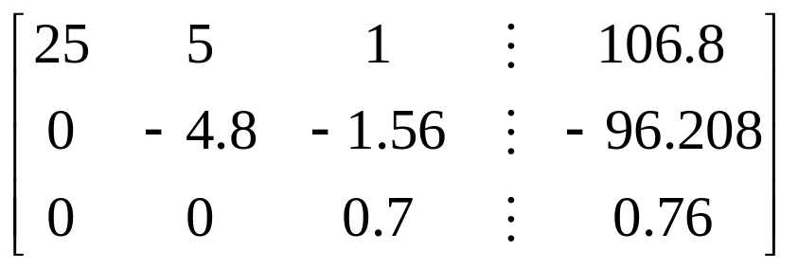
Forward Elimination: Step 2
Divide Equation 2 by −4.8
and multiply it by −16.8,
.
Subtract the result from Equation 3
Substitute new equation for Equation 3

Slide 25
Back Substitution

Slide 26
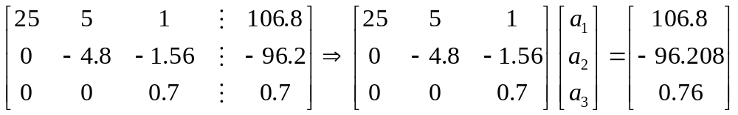
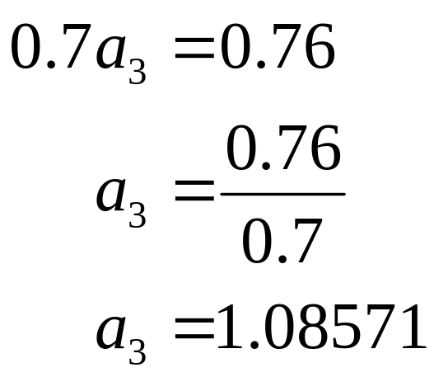
Back Substitution
Solving for a₃

Slide 27
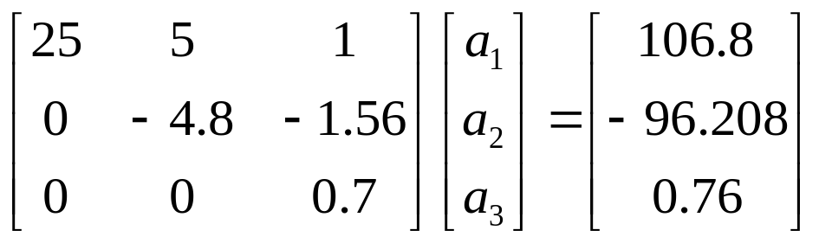
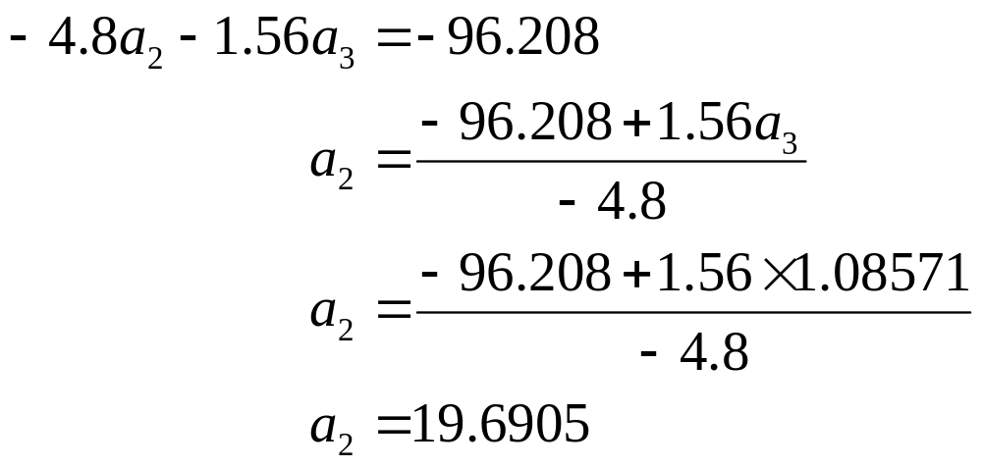
Back Substitution (cont.)
Solving for a₂

Slide 28
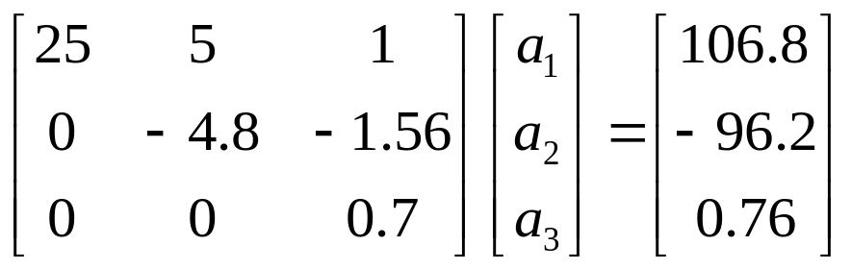
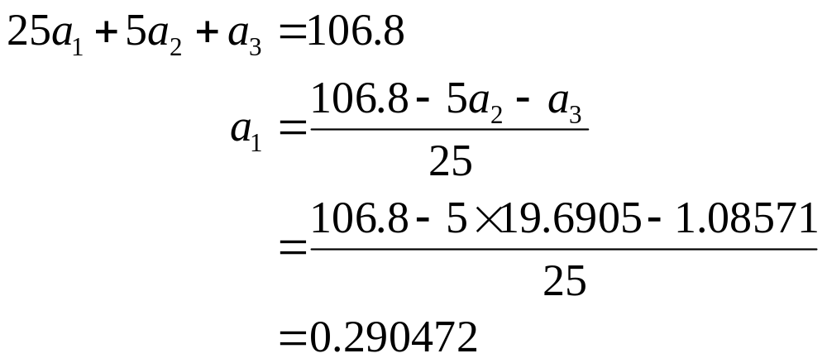
Back Substitution (cont.)
Solving for a₁

Slide 29

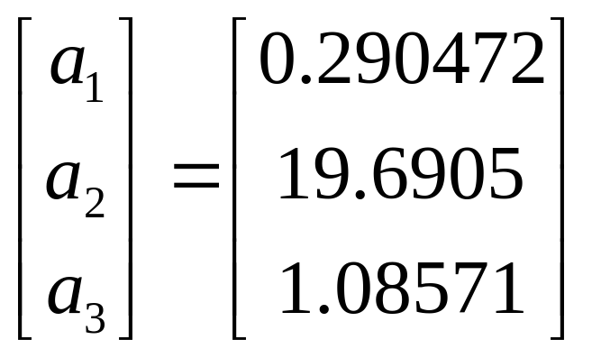
Naïve Gaussian Elimination Solution

Slide 30
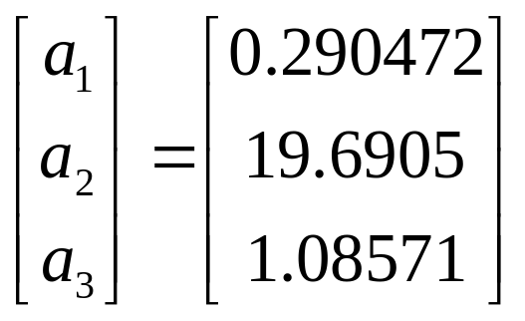
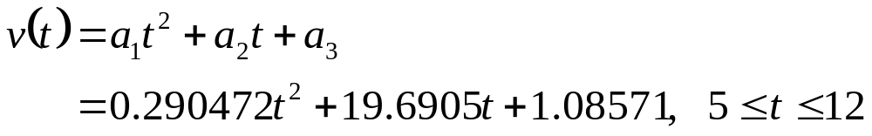
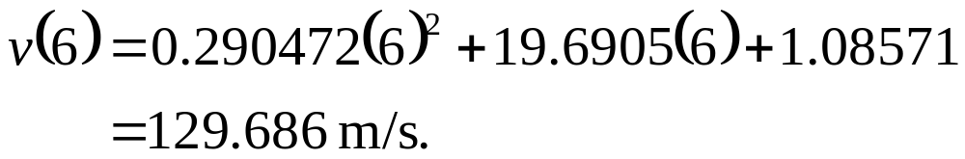
Example 1 Cont.
Solution
The solution vector is
The polynomial that passes through the three data points is then:

Slide 31
THE END

Slide 32
Naïve Gauss Elimination
Pitfalls

Slide 33
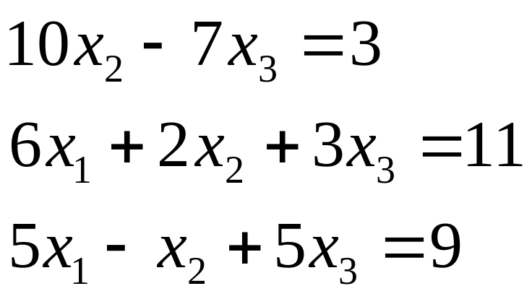
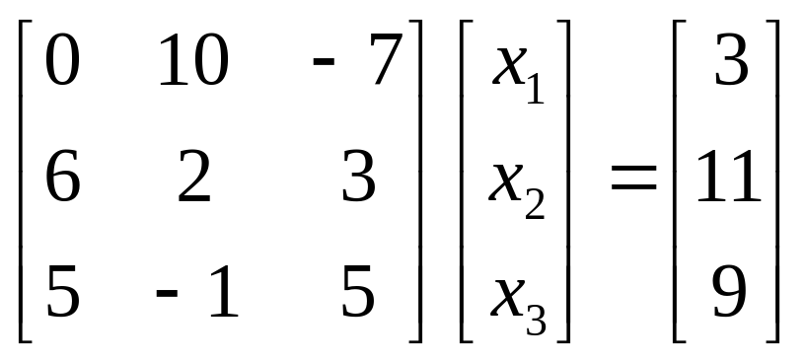
Pitfall#1. Division by zero

Slide 34
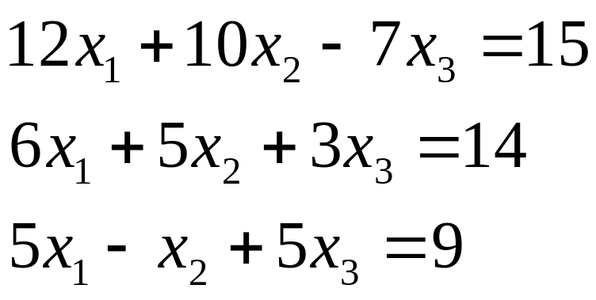

Is division by zero an issue here?

Slide 35



Is division by zero an issue here? YES
Division by zero is a possibility at any step of forward elimination

Slide 36


Pitfall#2. Large Round-off Errors
Exact Solution

Slide 37

Pitfall#2. Large Round-off Errors
Solve it on a computer using 6 significant digits with chopping

Slide 38

Pitfall#2. Large Round-off Errors
Solve it on a computer using 5 significant digits with chopping
Is there a way to reduce the round off error?

Slide 39
Avoiding Pitfalls
Increase the number of significant digits
Decreases round-off error
Does not avoid division by zero

Slide 40
Avoiding Pitfalls
Gaussian Elimination with Partial Pivoting
Avoids division by zero
Reduces round off error

Slide 41
THE END

Slide 42
Gauss Elimination with Partial Pivoting

Slide 43
Pitfalls of Naïve Gauss Elimination
Possible division by zero
Large round-off errors

Slide 44
Avoiding Pitfalls
Increase the number of significant digits
Decreases round-off error
Does not avoid division by zero

Slide 45
Avoiding Pitfalls
Gaussian Elimination with Partial Pivoting
Avoids division by zero
Reduces round off error

Slide 46



What is Different About Partial Pivoting?
At the beginning of the k^{th} step of forward elimination, find the maximum of
If the maximum of the values is
in the p ^{th} row,
then switch rows p and k.

Slide 47

Matrix Form at Beginning of 2nd Step of Forward Elimination

Slide 48

Example (2nd step of FE)
Which two rows would you switch?

Slide 49

Example (2nd step of FE)
Switched Rows

Slide 50
Gaussian Elimination with Partial Pivoting
A method to solve simultaneous linear equations of the form [A][X]=[C]
Two steps
1. Forward Elimination
2. Back Substitution

Slide 51
Forward Elimination
Same as naïve Gauss elimination method except that we switch rows before each of the (n-1) steps of forward elimination.

Slide 52
Example: Matrix Form at Beginning of 2nd Step of Forward Elimination

Slide 53
Matrix Form at End of Forward Elimination

Slide 54
Back Substitution Starting Eqns
. .
. .
. .

Slide 55
Back Substitution

Slide 56
THE END

Slide 57
Gauss Elimination with Partial Pivoting
Example

Slide 58

Example 2
Solve the following set of equations by Gaussian elimination with partial pivoting

Slide 59


Example 2 Cont.
Forward Elimination
Back Substitution

Slide 60
Forward Elimination

Slide 61
Number of Steps of Forward Elimination
Number of steps of forward elimination is (n−1)=(3−1)=2

Slide 62


Forward Elimination: Step 1
Examine absolute values of first column, first row
and below.
Largest absolute value is 144 and exists in row 3.
Switch row 1 and row 3.

Slide 63




Forward Elimination: Step 1 (cont.)
Divide Equation 1 by 144 and
multiply it by 64, .
.
Subtract the result from Equation 2
Substitute new equation for Equation 2

Slide 64




Forward Elimination: Step 1 (cont.)
Divide Equation 1 by 144 and
multiply it by 25, .
.
Subtract the result from Equation 3
Substitute new equation for Equation 3

Slide 65


Forward Elimination: Step 2
Examine absolute values of second column, second row
and below.
Largest absolute value is 2.917 and exists in row 3.
Switch row 2 and row 3.

Slide 66




Forward Elimination: Step 2 (cont.)
Divide Equation 2 by 2.917 and
multiply it by 2.667,
.
Subtract the result from Equation 3
Substitute new equation for Equation 3

Slide 67
Back Substitution

Slide 68


Back Substitution
Solving for a₃

Slide 69


Back Substitution (cont.)
Solving for a₂

Slide 70

Back Substitution (cont.)
Solving for a₁

Slide 71


Gaussian Elimination with Partial Pivoting Solution

Slide 72
Gauss Elimination with Partial Pivoting
Another Example

Slide 73




Partial Pivoting: Example
Consider the system of equations
In matrix form
=
Solve using Gaussian Elimination with Partial Pivoting using five significant digits with chopping

Slide 74



Partial Pivoting: Example
Forward Elimination: Step 1
Examining the values of the first column
|10|, |-3|, and |5| or 10, 3, and 5
The largest absolute value is 10, which means, to follow the rules of Partial Pivoting, we switch row1 with row1.
Performing Forward Elimination

Slide 75

Partial Pivoting: Example
Forward Elimination: Step 2
Examining the values of the first column
|-0.001| and |2.5| or 0.0001 and 2.5
The largest absolute value is 2.5, so row 2 is switched with row 3
Performing the row swap

Slide 76

Partial Pivoting: Example
Forward Elimination: Step 2
Performing the Forward Elimination results in:

Slide 77



Partial Pivoting: Example
Back Substitution
Solving the equations through back substitution

Slide 78


Partial Pivoting: Example
Compare the calculated and exact solution
The fact that they are equal is coincidence, but it does illustrate the advantage of Partial Pivoting

Slide 79
THE END

Slide 80
Determinant of a Square Matrix
Using Naïve Gauss Elimination
Example

Slide 81
Theorem of Determinants
If a multiple of one row of [A]_{nxn} is added or subtracted to another row of [A]_{nxn} to result in [B]_{nxn} then det(A)=det(B)

Slide 82

Theorem of Determinants
The determinant of an upper triangular matrix [A]_{nxn} is given by

Slide 83


Forward Elimination of a
Square Matrix
Using forward elimination to transform [A]_{nxn} to an upper triangular matrix, [U]_{nxn}.

Slide 84

Example
Using naïve Gaussian elimination find the determinant of the following square matrix.

Slide 85
Forward Elimination

Slide 86



Forward Elimination: Step 1
Divide Equation 1 by 25 and
multiply it by 64, .
.
Subtract the result from Equation 2
Substitute new equation for Equation 2

Slide 87



Forward Elimination: Step 1 (cont.)
Divide Equation 1 by 25 and
multiply it by 144, .
.
Subtract the result from Equation 3
Substitute new equation for Equation 3

Slide 88



Forward Elimination: Step 2
Divide Equation 2 by −4.8
and multiply it by −16.8,
.
.
Subtract the result from Equation 3
Substitute new equation for Equation 3

Slide 89


Finding the Determinant
After forward elimination
.

Slide 90
Summary
Forward Elimination
Back Substitution
Pitfalls
Improvements
Partial Pivoting
Determinant of a Matrix

Slide 91
THE END

